Slide 1

National Grid ESO
Markets
Organisational structure
Updated: October 2023

Slide 2

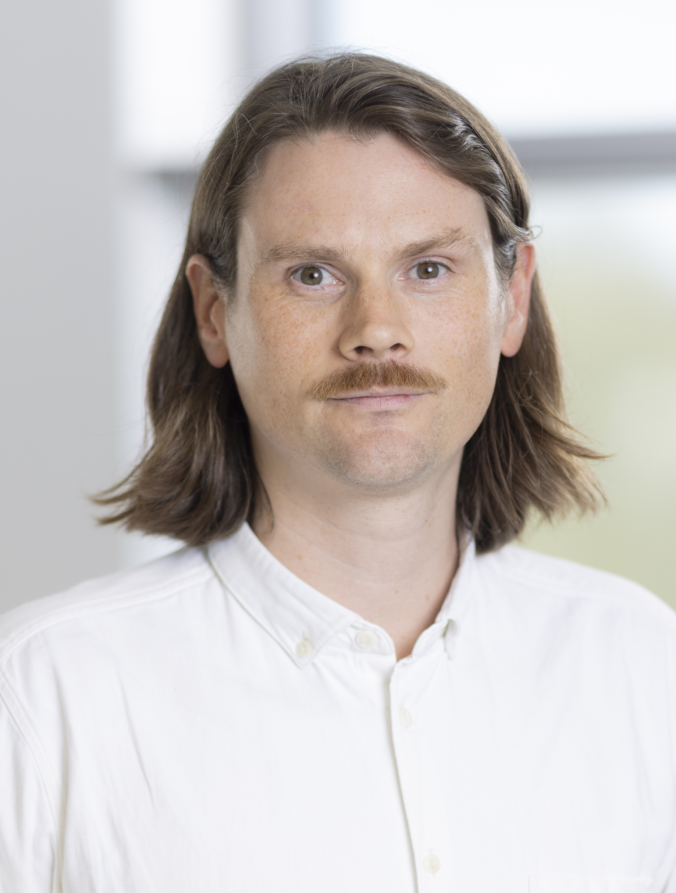
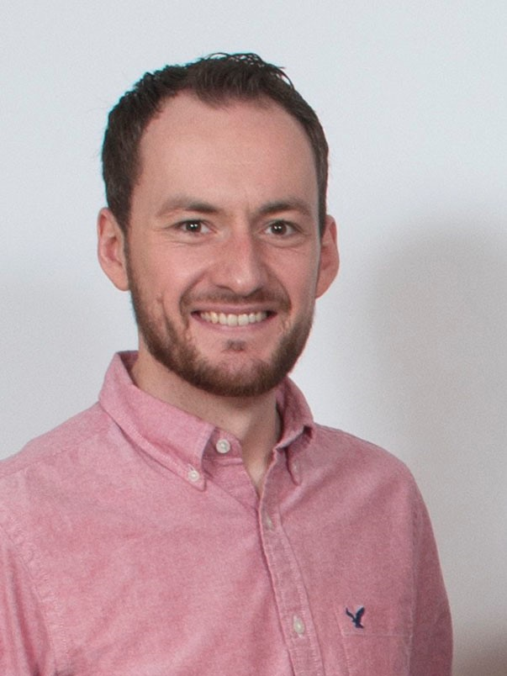



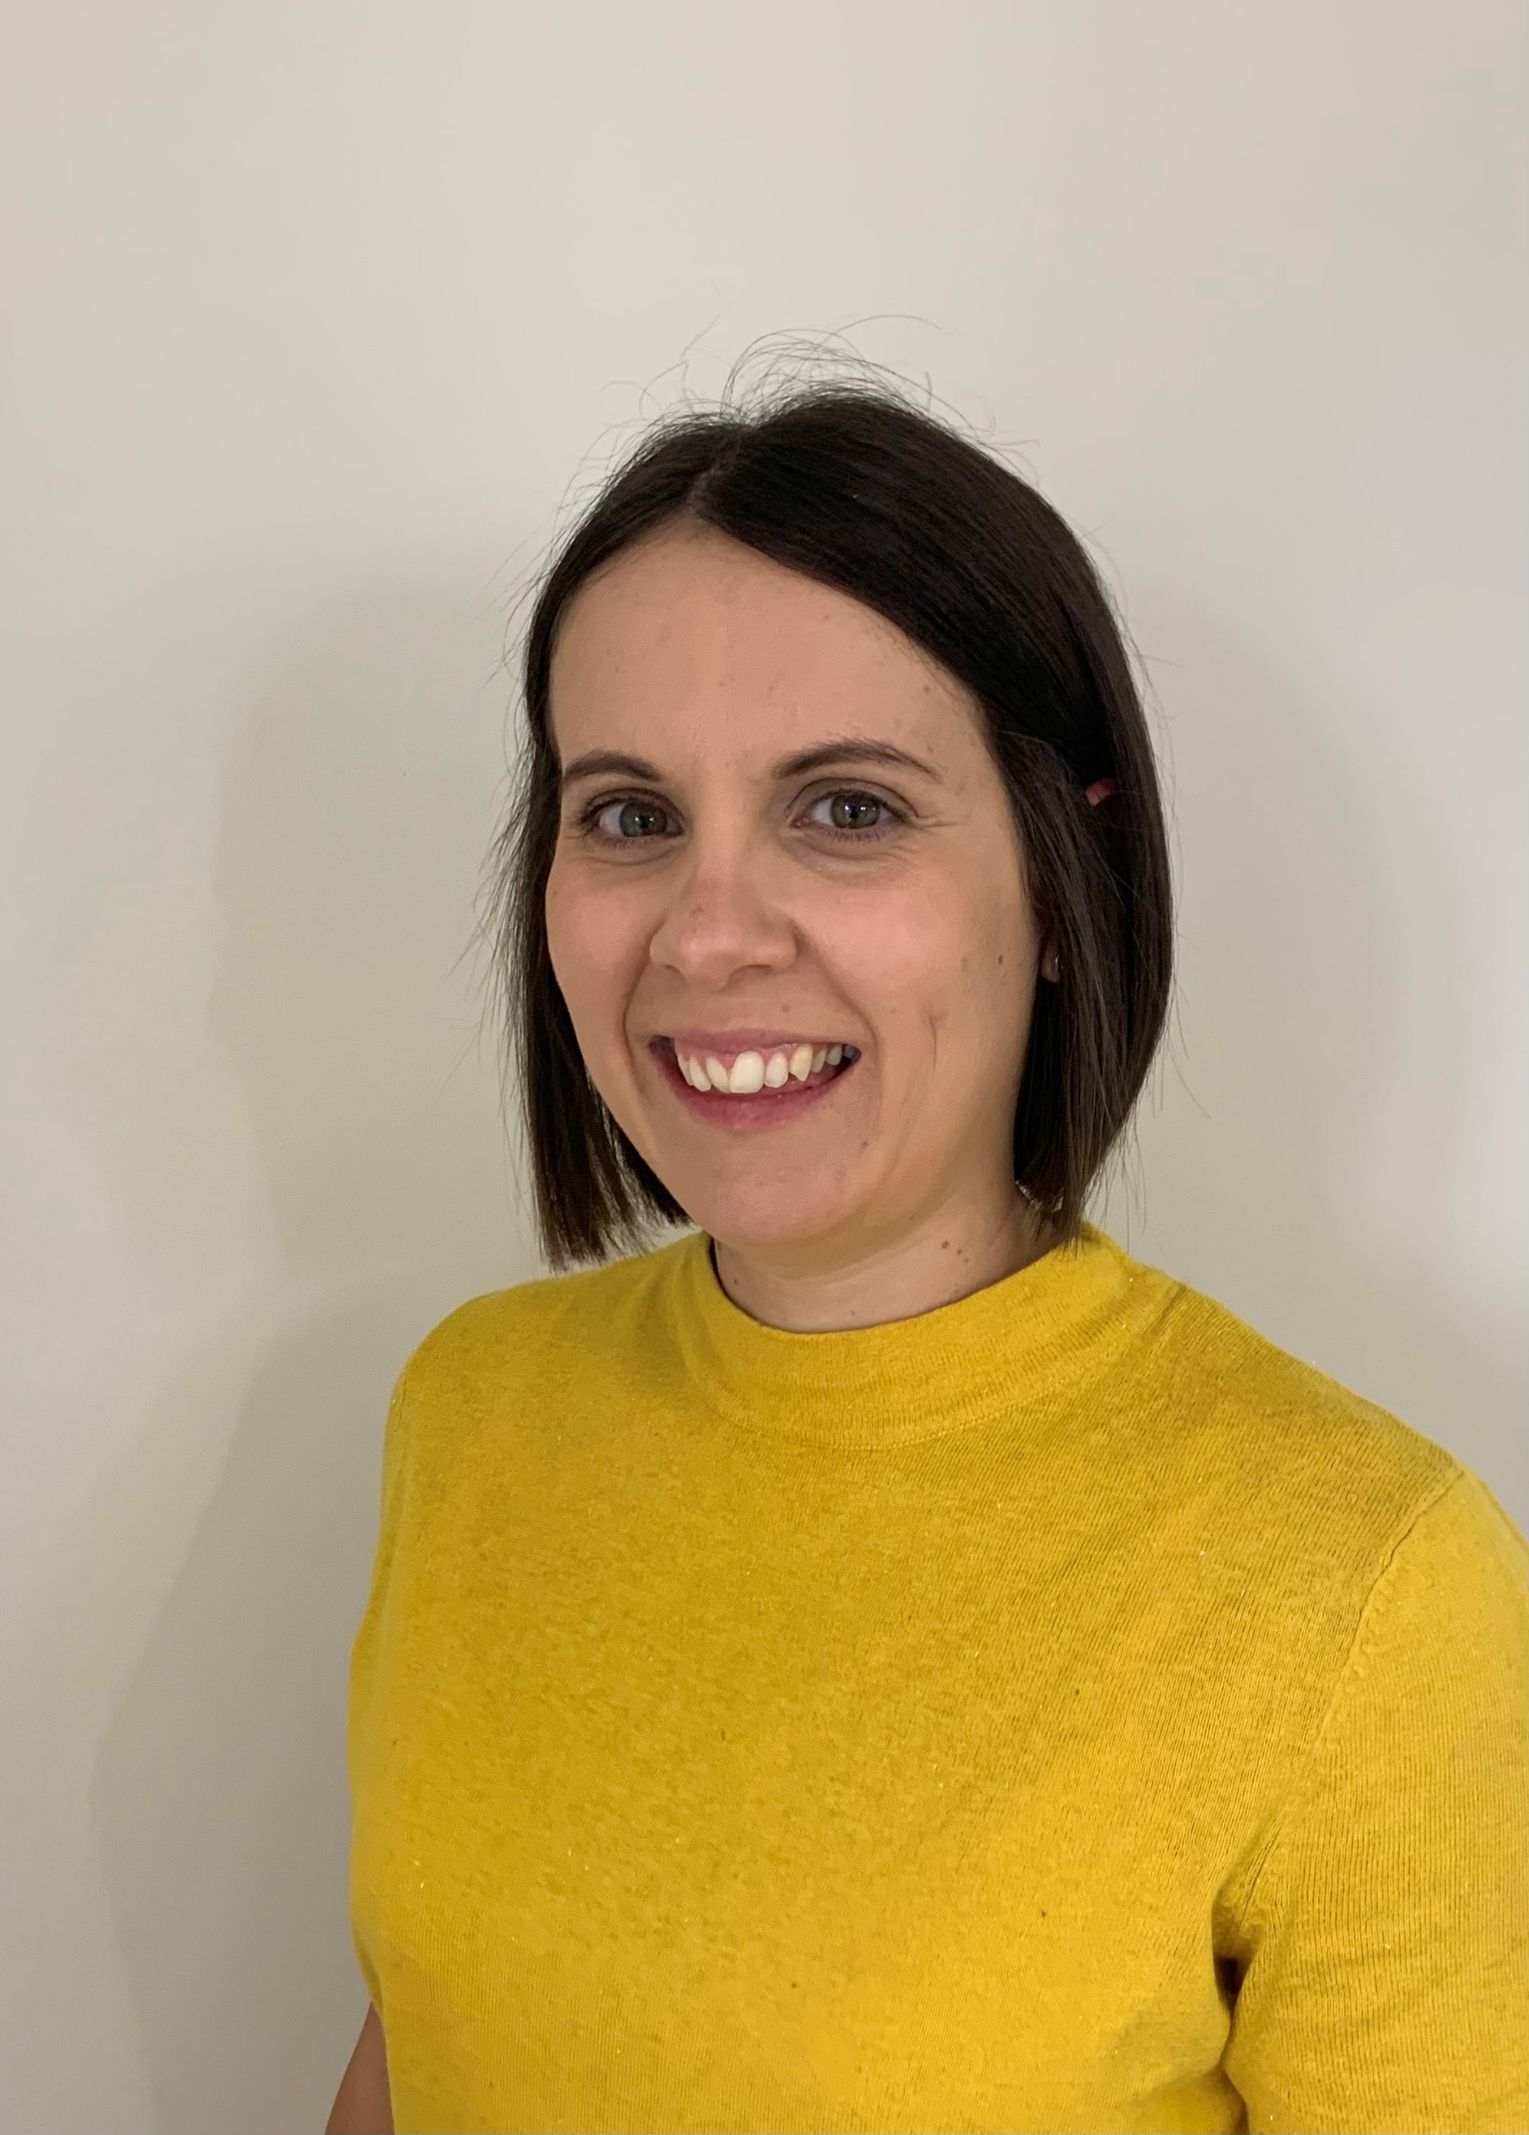
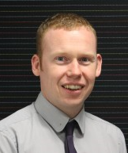

Markets Leadership Team
Claire Dykta
Director of Markets
claire.dykta@nationalgrideso.com
+44 (0) 7824 383 808
National Grid ESO balances Great Britain’s electricity system using a mix of power generation to ensure that, whatever the mix, electricity is always there when it's needed.
Our mission is to enable the transformation to a sustainable energy system and ensure the delivery of reliable affordable energy for all consumers.
Markets delivers critical business activities to enable market participants to participate in real-time markets meeting the needs of our customers both today and in the future to deliver consumer value as the GB electricity system decarbonizes.
Markets works strategically to anticipate and influence future change, and acts as a Strategic Advisor to government and Ofgem on market reform. We develop new products, systems and industry codes to ensure the ESO can operate the system securely, maintaining security of supply to deliver the best outcome for both consumers and ESO incentive performance.
Markets have a mandate from Government to deliver EMR obligations through the role of EMR Delivery Body. This includes both the Capacity Market and Contracts for Difference for which we are trusted to provide expertise to support Government decision-making.
There are over 250 ESO colleagues who work in Markets and we understand that it can be difficult for some of our customers to identify the right people to contact, which can be frustrating. In recognition of this, we have produced a presentation that sets out the organisational structure of the Markets team, with contact details for all senior managers and managers. We hope that this is helpful.
Cian McLeavey-Reville
Head of Markets Development
cian.mcleavey-reville@nationalgrideso.com
+44 (0) 7779 980 254
Rob Marshall
Head of Market Services
rob.marshall@nationalgrideso.com
+44 (0) 7824 518 958
Jon Wisdom
Head of Market Change Delivery
jon.wisdom@nationalgrideso.com
+44 (0) 7929 375 010
Rebecca Yang
Head of EMR Delivery Body
rebecca.yang@nationalgrideso.com
+44 (0) 7917 174 420
Jamie Webb
Head of Market Frameworks (interim)
jamie.webb@nationalgrideso.com
+44 (0)
Amy Weltevreden
Head of Flexibility Market Strategy
amy.weltevreden@nationalgrideso.com
+44 (0)
Andy Dobbie
Head of EMR Modelling
andrew.dobbie2@nationalgrideso.com
+44 (0) 7966 551 760
Cathy Fraser
Head of Market Requirements
cathy.fraser@nationalgrideso.com
+44 (0) 7973 677997

Slide 3
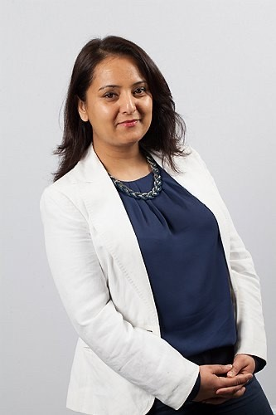

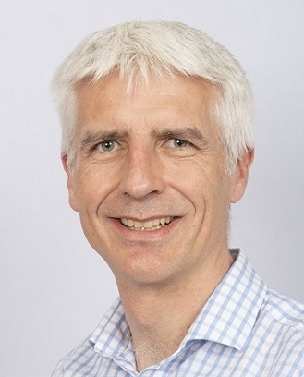

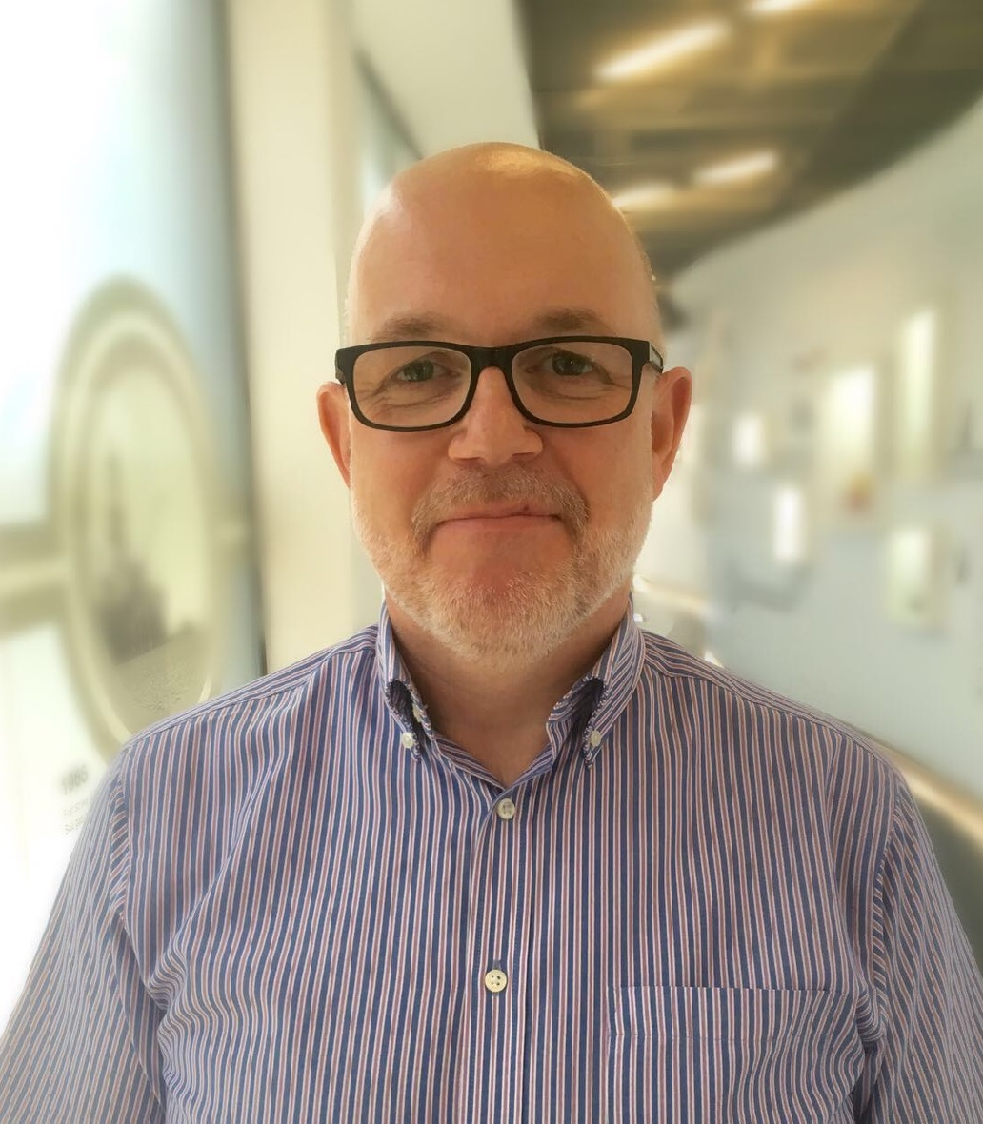
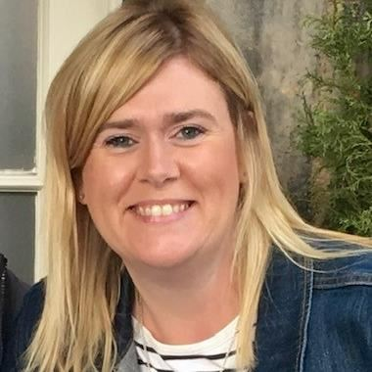
Market Services
Rob Marshall
Head of Market Services
Leads the Market Services team
rob.marshall@nationalgrideso.com
+44 (0) 7824 518 958
The Market Services team leads on the provision of functions that support the wider electricity industry. This includes the procurement of balancing services for utilisation within the control room and the financial settlement for these services.
Our team provides the Code secretariate function administering the Connection and Use of System Code (CUSC), Grid Code, System Operator Transmission Owner Code (STC) and Security and Quality of Supply Standard (SQSS), as well as running our Charging Futures Forum.
We also undertake tariff setting activities and recovers network charges (Transmission Network Use of System (TNUoS), Balancing Services Use of System (BSUoS), Assistance for areas with high electricity distribution costs (AAHEDC) and Connections Charges) on behalf of the industry.
The best way to contact us is through our team email addresses provided below, which are monitored regularly. Alternatively, we have also provided contact details for some members of the team.
Ancillary Services queries: settlement.queries@nationalgrideso.com
BSUoS queries: BSUoS.queries@nationalgrideso.com
Charging Futures: ChargingFutures@nationalgrideso.com
Connection charging queries: transmissionconnectioncharging@nationalgrideso.com
CUSC queries: cusc.team@nationalgrideso.com
Grid Code queries: Grid.Code@nationalgrideso.com
SQSS queries: box.SQSS@nationalgrideso.com
STC queries: STCTeam@nationalgrideso.com
TNUoS and AAHEDC queries: TNUoS.queries@nationalgrideso.com
Trades queries: commodities@nationalgrideso.com
General queries: Commercial.Operation@nationalgrideso.com
Nina Bhogal
Systems Manager
Leads on the system replacement projects for Market Services.
nina.bhogal@nationalgrideso.com
+44 (0) 7977 583 097
Steve Miller
Contracts Manager
Responsible for procurement of balancing services in day long term markets and for the provision of an account management service to our service providers.
steve.k.miller@nationalgrideso.com
+44 (0)
Nick George
Revenue and Charging Manager
Responsible for collection of all the electricity transmission network charges in the UK incl. TNUoS, BSUoS, AAHEDC and Connections charges.
nick.george@nationalgrideso.com
+44 (0) 7973 915 455
Roop Phull
Contracts Manager Day Ahead Markets
Responsible for procurement of balancing services in day ahead markets and for the provision of an account management service to our service providers.
roopkamal.phull@nationalgrideso.com
+44 (0) 7971 822919
Nick Everitt
Revenue Manager, Tariff Setting
Responsible for the tariff setting arrangements that the ESO administers
nick.everitt@nationalgrideso.com
+44 (0) 7866 982 328
Sally Willetts
Settlements Manager
Responsible for the monthly settlement of Ancillary Services that the ESO procures and for settling the trades that the ESO undertakes.
sally-anne.willetts@nationalgrideso.com
+44 (0)

Slide 4
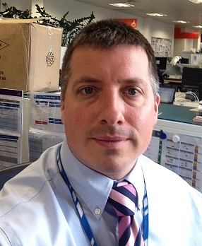


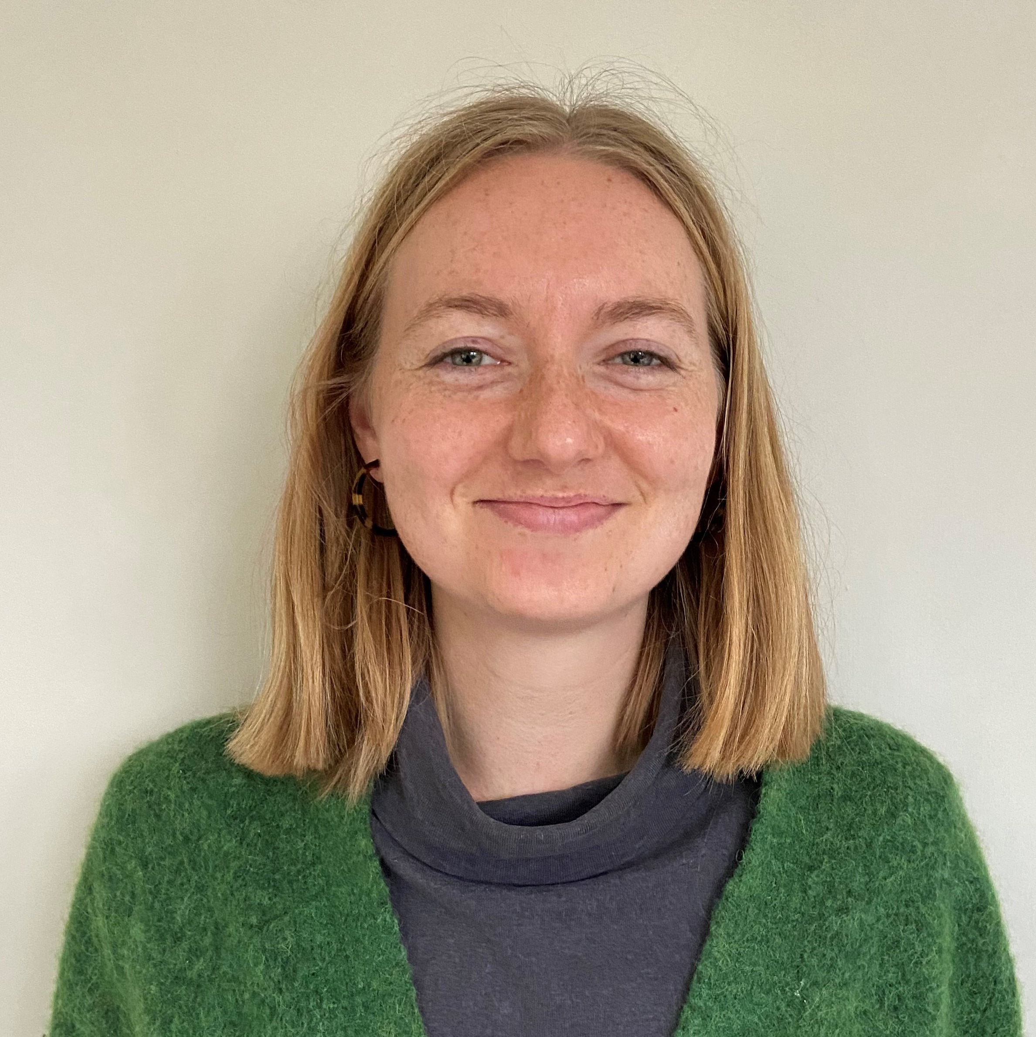
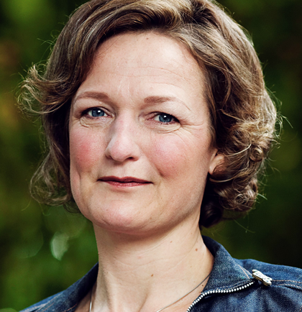
Markets Development
The Market Development team is responsible for analysing the suitability of current markets and working closely with stakeholders to understand how best to develop those markets and frameworks as the energy system evolves.
The Market Strategy team is responsible for recommending holistic long-term (2035+) market reform to facilitate net zero.
The Electricity Market Development team defines the strategic directions for ESO balancing services markets. The team owns ESO's Market Design Framework and publishes the Markets Roadmap.
The Cross-Border EU team has accountability for both Cross Border and EU strategy for the ESO business, developing a holistic approach to domestic, EU and I/C strategy.
The Whole Energy Market Strategy team is responsible for assessing interdependencies between the markets for different vectors, and identifying opportunities for efficient reforms to facilitate net zero.
Cian McLeavey-Reville
Head of Markets Development
Leads the Markets Development team
cian.mcleavey-reville@nationalgrideso.com
+44 (0) 7779 980 254
Tom Ireland
Cross Border and EU Manager
Developing ESO’s cross border strategy and managing the ESO forward from the UK’s EU-Exit.
thomas.ireland@nationalgrideso.com
+44 (0) 7766 698 314
Fang Fang
Whole Energy Market Strategy Manager
Developing ESO recommendations for how markets across different vectors and sectors should be reformed for net zero
fang.fang@nationalgrideso.com
+44 (0)
Becky Hart
Electricity Market Development Manager
Responsible for developing future ESO electricity markets roadmap in line with ESO's market development principles.
becky.hart@nationalgrideso.com
+44 (0) 7866 159308
Isabel Sunnucks
Market Strategy Manager
Developing ESO recommendations on holistic long-term (2030-2050) market design to facilitate net zero, initially via the Net Zero Market Reform project.
isabel.sunnucks@nationalgrideso.com
+44 (0) 7966 161 691
Sarah Keay-Bright
Market Strategy Manager
Developing ESO recommendations on holistic long-term (2030-2050) market design to facilitate net zero, initially via the Net Zero Market Reform project.
sarah.keay-bright@nationalgrideso.com
+44 (0) 7548 106 689

Slide 5
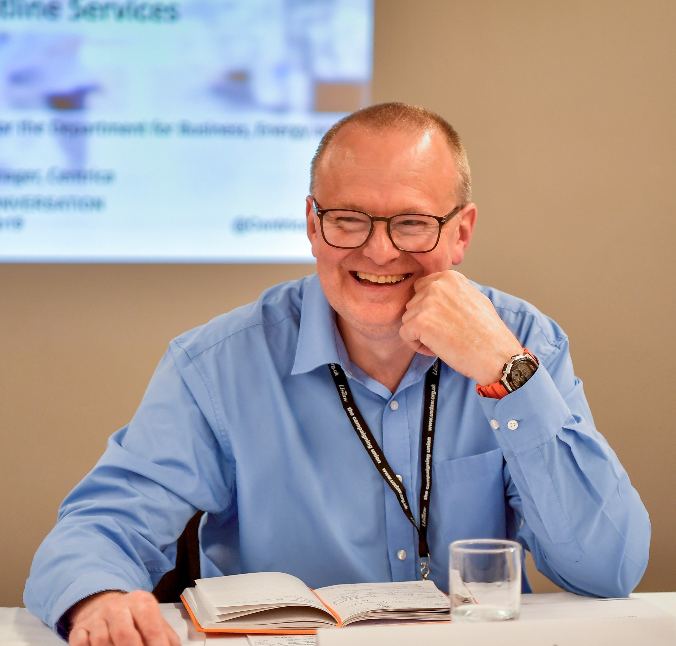


Flexibility Market Strategy
The Flexibility Market Strategy team is the strategic engine thinking about the development and growth of flexibility markets that are vital in meeting our zero carbon operation ambitions. The team aims to enable and unlock flexibility, including distributed generation, storage, and demand side flexibility such as EV charging and electric heating. We engage and collaborate with a variety of stakeholders industry experts and innovators to design the roadmap to achieve that vision.
Amy Weltevreden
Head of Flexibility Market Strategy
Leads the Flexibility Market Strategy team.
amy.weltevreden@nationalgrideso.com
+44 (0) 7973 606061
Stuart Fowler
Flexibility Co-ordination Manager
Leading the discussions with the industry to enable ESO and DSO's to procure flexibility services in a coordinated way to ensure best value for customers.
stuart.fowler@nationalgrideso.com
+44 (0) 7938 735475
Karen Thompson-Lilley
Customer & Stakeholder Strategy Manager
Leads on Customer & Stakeholder Strategy across the Markets function
karen.thompson-lilley@nationalgrideso.com
+44 (0) 7354 901829
Yujia Du
Distributed Flexibility Strategy Manager
Developing ESO's long-term strategy to facilitate the growth of distributed flexibility.
yujia.du@nationalgrideso.com
+44 (0) 7548 780 556

Slide 6

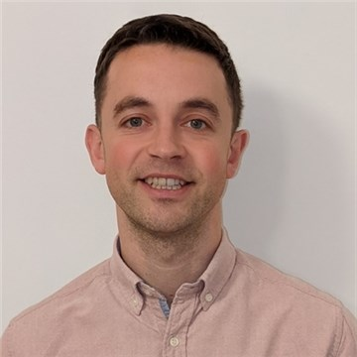
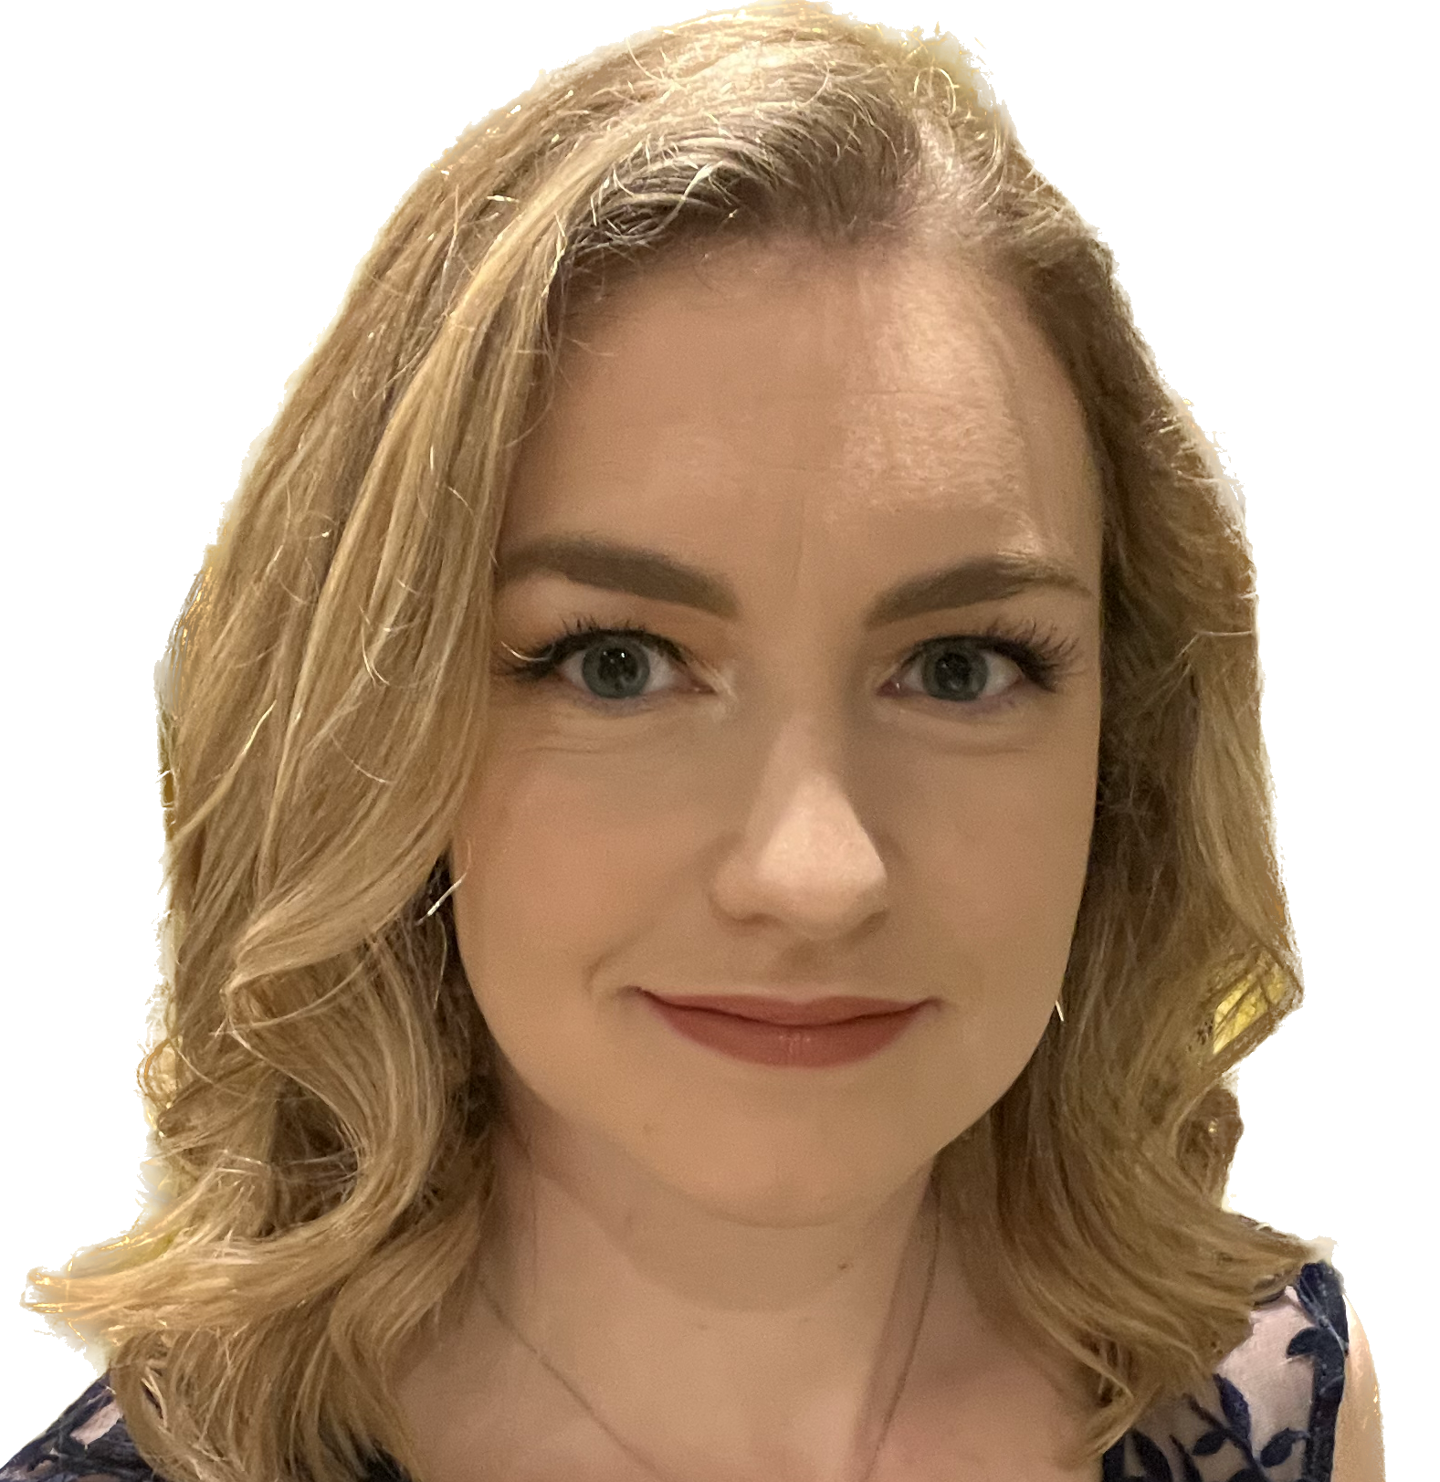

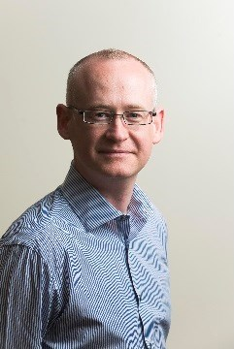


Market Change Delivery
The Market Change Delivery (MCD) team is responsible for developing and delivering the range of new products and services that will allow the Electricity System Operator (ESO) to operate a net zero power system with a wide range of diverse market participants.
This includes ancillary service reform where we are delivering new response and reserve products, pathfinder projects aimed at finding innovative new ways to operate the electricity system and new platforms to facilitate industries engagement with the ESO.
Jon Wisdom
Head of Market Change Delivery
Leads the Market Change Delivery team.
jon.wisdom@nationalgrideso.com
+44 (0) 7929 375 010
Yuting Dai
Ancillary Services Development Manager
Leading the ESOs work on potential solutions to reform the reactive power services to address the challenges we are facing for system voltage control. Yuting is also responsible for the implementation of pathfinder projects.
yuting.dai@nationalgrideso.com
+44 (0) 7971 537 826
Richard Hanson
Flexibility Service Development Manager
Leading the ESOs Enduring Auction Capability project which will improve the procurement of ancillary services. Rich is also responsible for delivering the commercial element of voltage, stability and constraint management pathfinder projects.
richard.hanson2@nationalgrideso.com
+44 (0) 7917 503 317
Hannah Rochford
Ancillary Services Development Manager
Leading the ESOs work into enabling participation for renewables and other non-traditional market participants in our response and reserve markets
hannah.rochford1@nationalgrideso.com
+44 (0) 7966 186074
Joseph Donohoe
Ancillary Services Development Manager
Leading the ESOs response reform work which includes being the Product Manger for Dynamic Containment, Dynamic Moderation and Dynamic Regulation services.
joseph.donohoe@nationalgrideso.com
+44 (0) 7811 975 364
David Preston
Product Manager – Single Markets Platform
Product Manager for the ESOs work on the Single Markets Platform that will facilitate access to the ESO markets for a wide range of diverse market participants.
david.a.preston@nationalgrideso.com
+44 (0) 7768 712 356
Callum Wright
Power Responsive Manager
Callum leads our work on Power Responsive programme and the Local Constraint Market.
callum.wright@nationalgrideso.com
+44 (0) 7752461845
Mili Gupta
Ancillary Services Development Manager
Product Manager for the Reserve Reform project including the quick and slow reserve products. Product Owner for the ESOs work on the Single Markets Platform that will facilitate access to the ESO markets for a wide range of diverse market participants.
mili.gupta@nationalgrideso.com
+44 (0) 7827 282 001

Slide 7
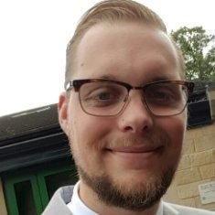
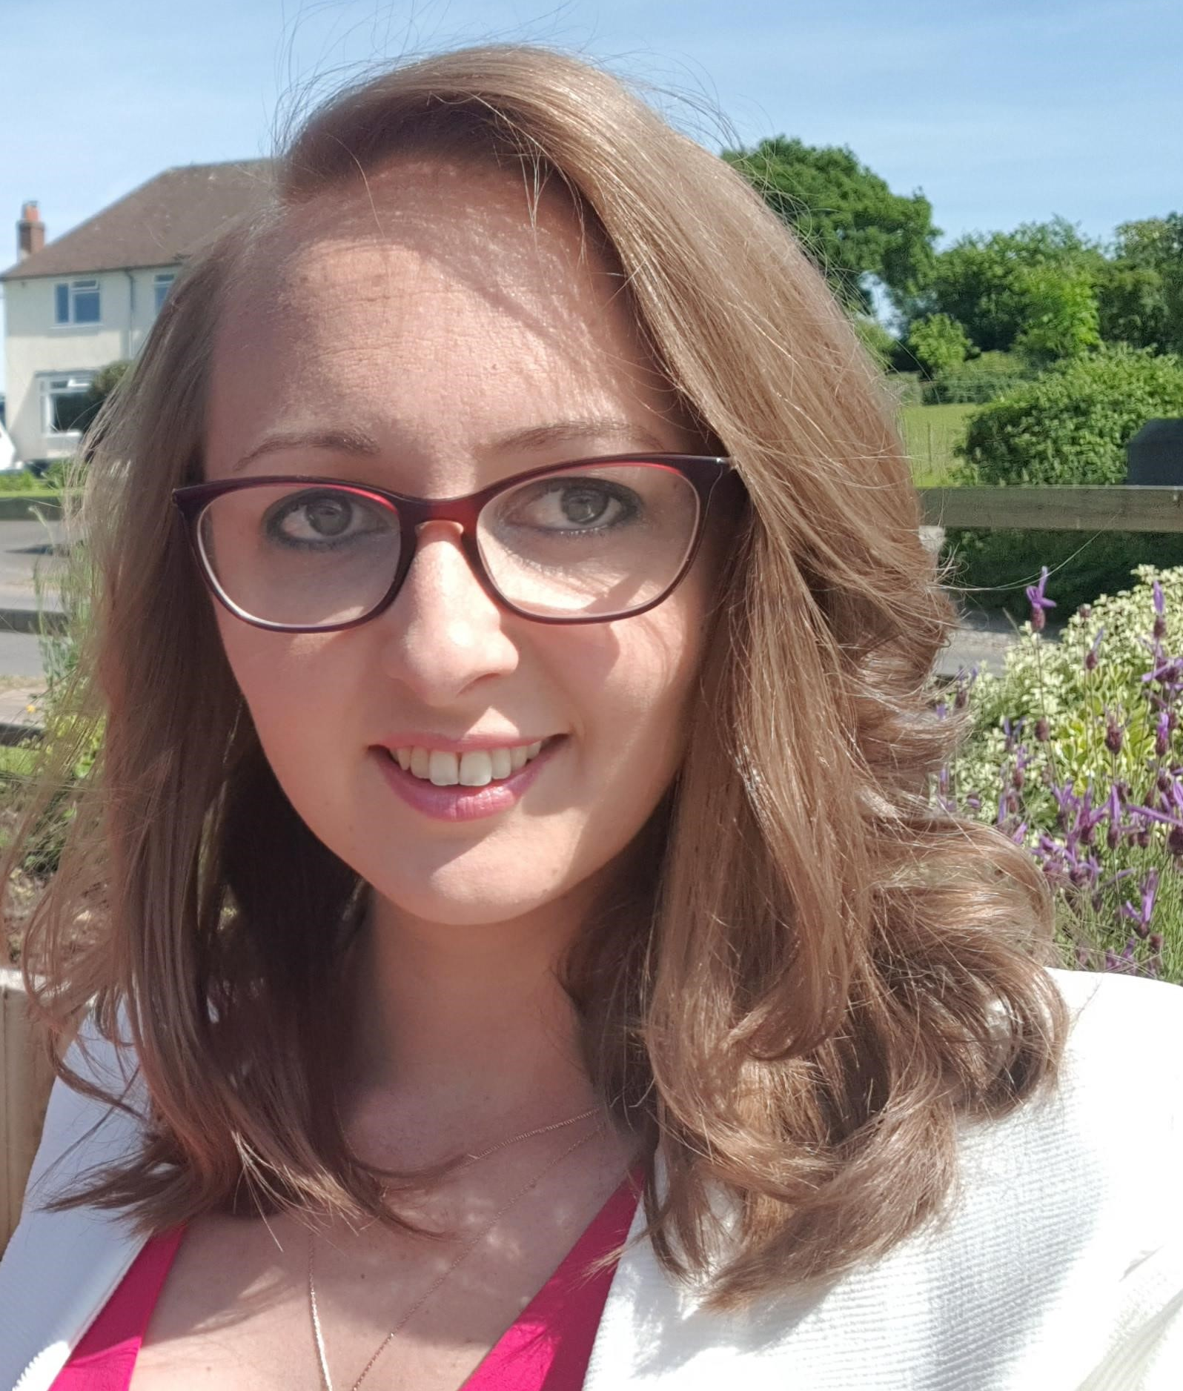
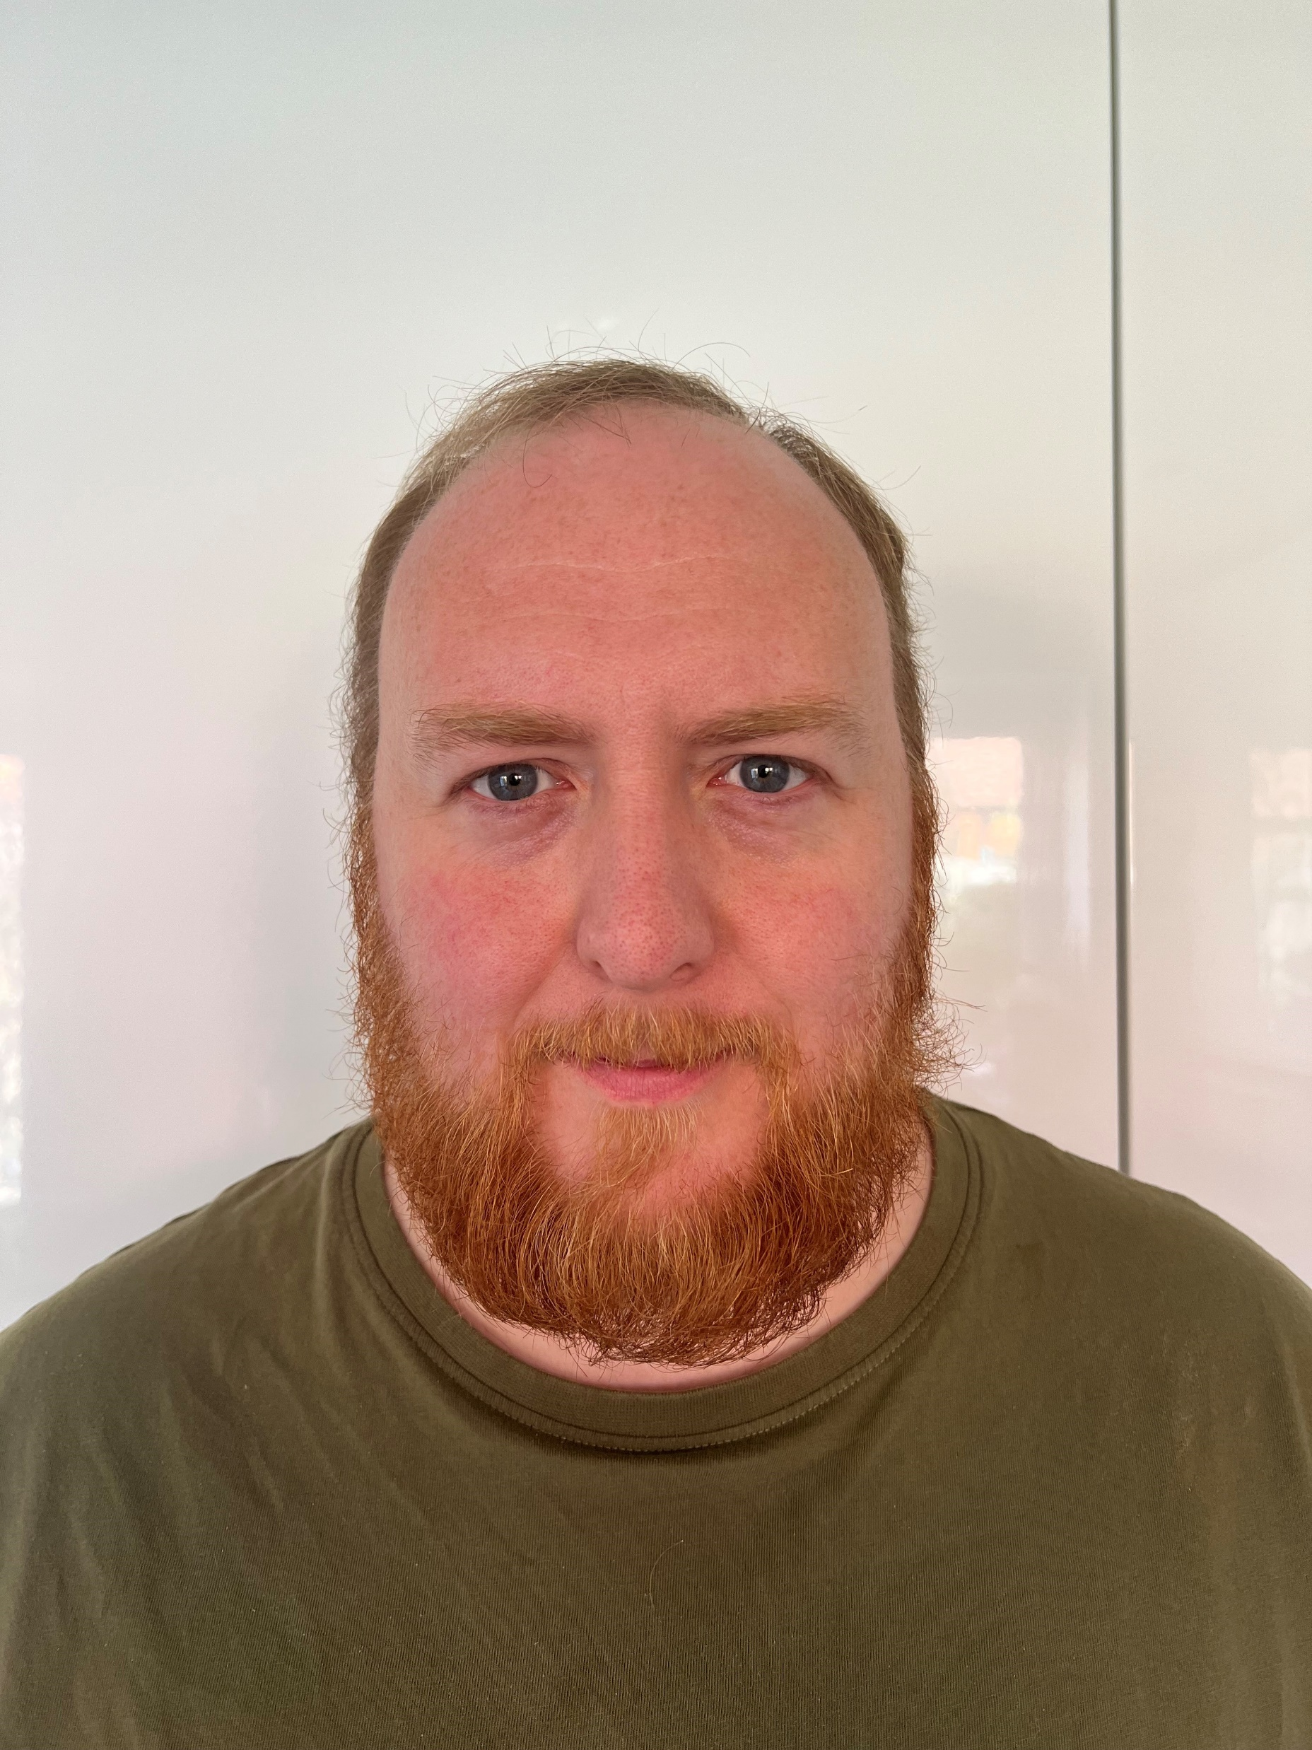
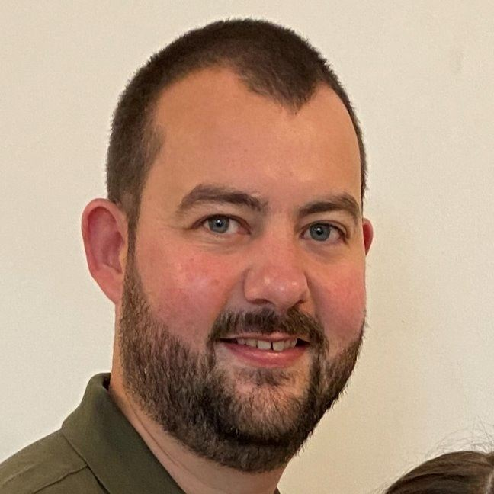
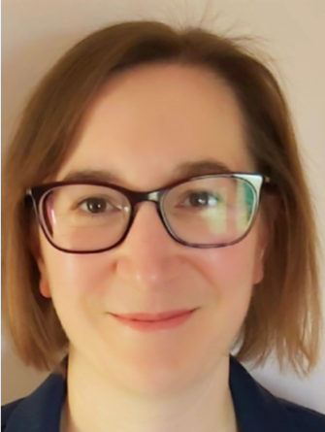
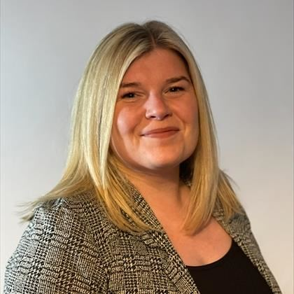


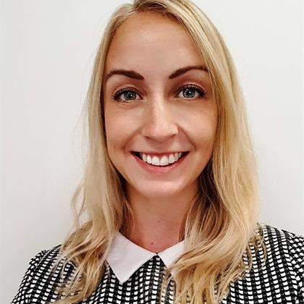
Market Frameworks
Jamie Webb (interim)
Head of Market Frameworks
Leads the Market Frameworks Team
jamie.webb@nationalgrideso.com
+44 (0) 7768 537317
The Market Frameworks team work across the GB technical and commercial codes, charging arrangements, and cross-border frameworks to ensure that these evolve and transform to enable efficient markets and optimal consumer benefit on the journey to a zero carbon electricity system.
The team has a critical role to play supporting our market development, design and delivery activities.
We work closely with our customers and stakeholders through the open governance process for industry codes as well as various industry work groups and governance functions.
Claire Huxley
Commercial Codes Manager
You can contact me about network charging arrangements (TNUoS and BSUoS) and the CUSC.
claire.huxley@nationalgrideso.com
+44 (0) 7971 672 772
Terry Baldwin
Technical Codes Manager (interim)
You can contact me about technical code matters including Grid Code, STC, the SQSS and the Whole System Technical Code Project.
terry.baldwin@nationalgrideso.com
+44 (0) 7814 778118
Christian Parsons
Transmission Charging Strategy Manager
You can contact me regarding TNUOS and the TNOUS Task Force
christian.parsons@nationalgrideso.com
+44 (0) 7816 996090
Claire Newton
European Frameworks Manager
You can contact me about developing and implementing post Brexit regulation and the Trade and cooperation agreement
claire.newton@nationalgrideso.com
+44 (0) 7708 290829
Keren Kelly
Whole System Frameworks Manager
You can contact me for insights and queries in relation to whole system operation and change.
keren.kelly1@nationalgrideso.com
+44 (0) 7768 537 317
Camille Gilsenan
European Industry Frameworks Manager
You can contact me about BSC related issues, as well as connection code related queries
camille.gilsenan@nationalgrideso.com
+44 (0) 7989 132429
Louise Trodden
European Frameworks Manager
You can contact me for retained EU law compliance , Clean Energy Package queries, Interconnector related queries and C16
louise.trodden@nationalgrideso.com
+44 (0) 7866 165538
Sarah Carter
Industry Code Governance Manager
You can contact me for all Code Governance related queries
sarah.carter@nationalgrideso.com
+44 (0) 7751744315

Slide 8

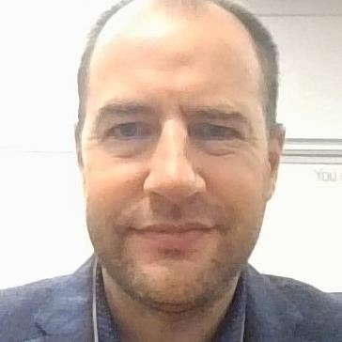
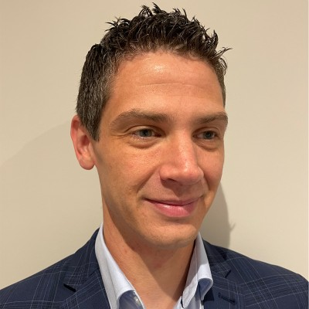
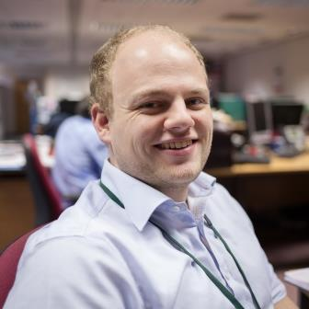
Market Requirements
The Market Requirements team lead across National Control, Markets and Networks in developing the ESO’s operational strategy for within season and season ahead.
We ensure delivery of mitigations to manage any emerging system risks to make sure the ESO’s control room has the tools in place to balance the national supply and demand of electricity second by second, as efficiently and cost effectively as possible.
We play a critical role in supporting our market development, design and delivery activities, working closely with the ESO’s Networks and National Control teams in support of our ESO ambitions to enable zero carbon system operation and competition everywhere.
The Market Requirements team create models and conduct complex risk analysis with a core focus on frequency risks and controls and assessment of electricity balancing services. This results in insights to inform and support high quality engagement with stakeholders at all levels across government, regulator and industry. The team is accountable for the procurement of our frequency services, from requirement setting to assessment, including running our daily auctions.
Cathy Fraser
Head of Market Requirements
Leads the Market Requirements team
cathy.fraser@nationalgrideso.com
+44 (0) 7973 677997
Qi Zhong
Frequency Risk & Modelling Manager
You can contact me about FRCR Policy and ESO response and reserve requirement settings.
qi.zhong@nationalgrideso,com
+44 (0) 7970 144 916
Nigel Swan
Balancing Services Optimisation Manager
You can contact my team about procurement of ancillary services
box.ancillaryassessment@nationalgrideso.com
Mike Coldwell
Market Requirements Future Design & Development Manager
You can contact me about technical and procurement design of new ancillary services.
box.futureofbalancingservices@nationalgrideso.com
Russell Woodman
Short Term Operability Manager (Interim)
You can contact me about any operability issues within season and season ahead.
russell.woodman@nationalgrid.com

Slide 9

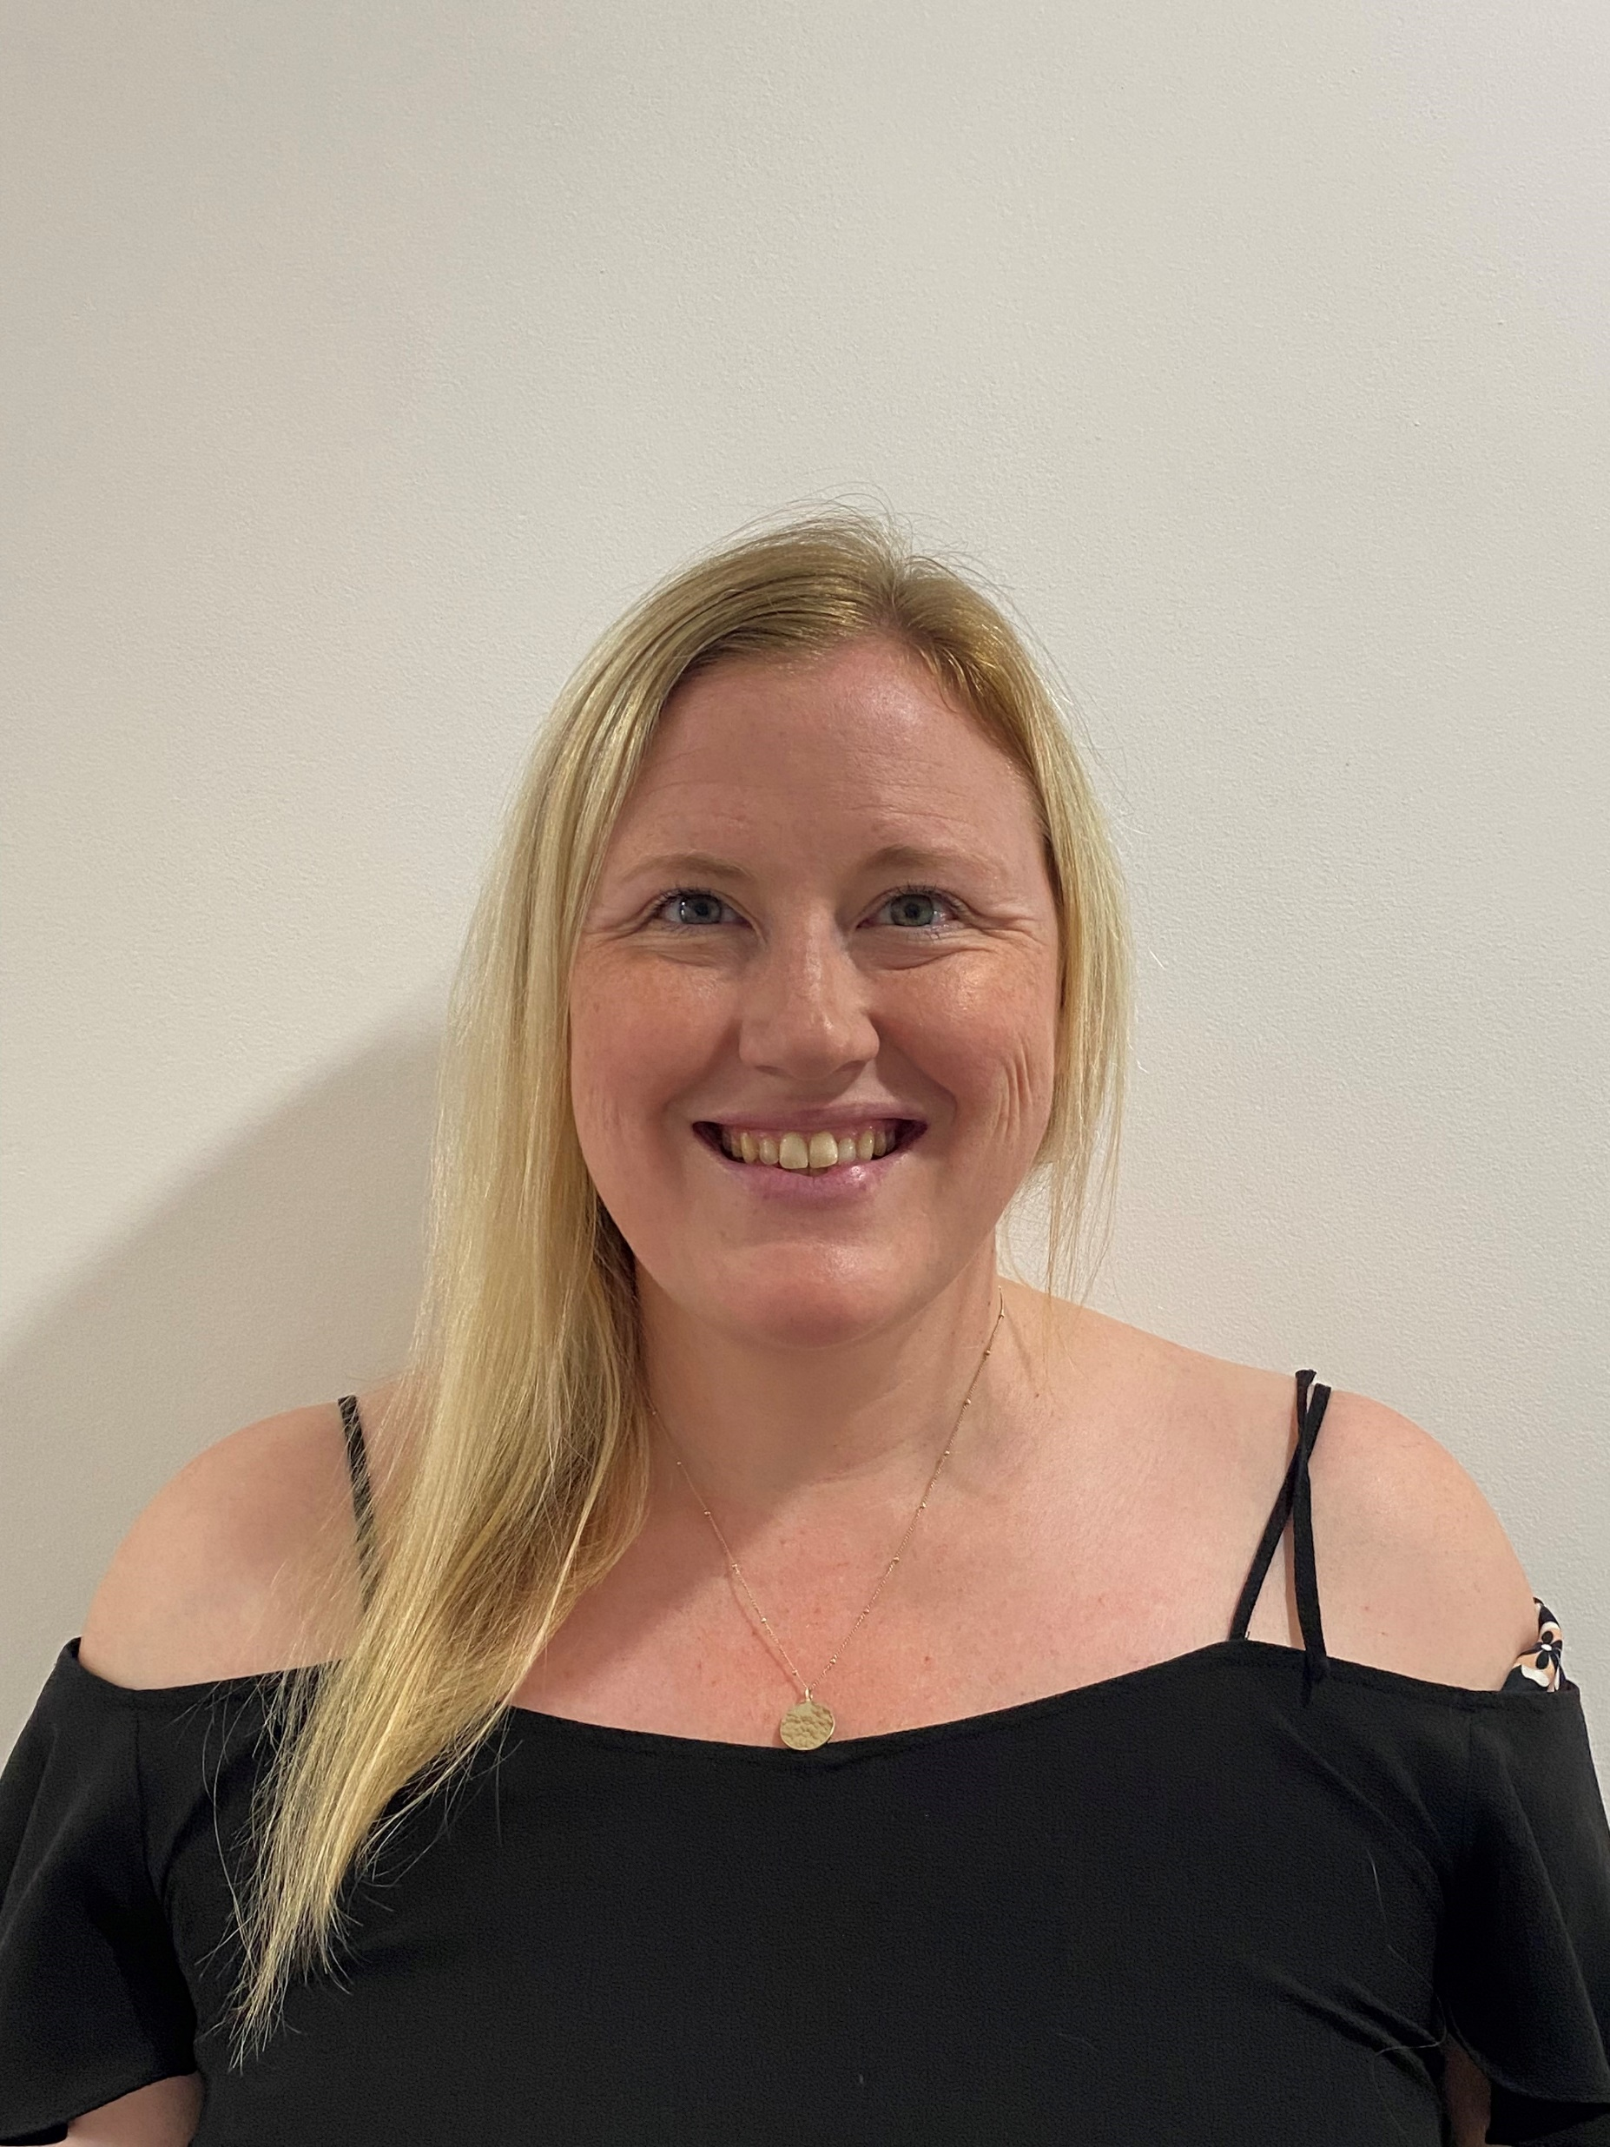

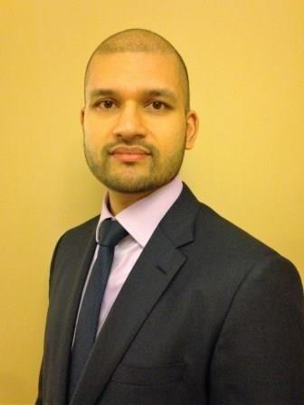
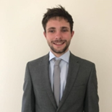




EMR Delivery Body
Rebecca Yang
Head of EMR Delivery Body
Leads the EMR Delivery Body team
rebecca.yang@nationalgrideso.com
+44 (0) 7917 174 420
Electricity Market Reform (EMR) aims to deliver low carbon energy supplies whilst maintaining security of supply and minimising the cost to the consumer. EMR introduces two key mechanisms to provide incentives​ for the investment required in our energy infrastructure. ​
The Capacity Market (CM) is one of the key policies of the EMR programme. The CM aims to ensure the future security of our electricity supply at the lowest cost to consumers by providing a regular retainer​ payment to reliable forms of capacity, in return for such capacity being available when the system is tight.
Contracts for Difference (​CfD) is one of the key mechanisms implemented by the UK Government as part of EMR to provide long-term price stabilisation to low ​carbon plant, allowing investment to come forward at a lower cost of capital and therefore at a lower cost to consumers. It has a critical role to play supporting our market development, design and delivery activities.
We work closely with external customers, DESNA and Ofgem and other stakeholders through various industry work groups.
The best way to contact the team is via the team email addresses, which are monitored regularly. Alternatively, we have also provided contact details for some members of the team.
Capacity Market Agreement Management: emr@nationalgrideso.com
Capacity Market Prequalification & Disputes: box.emr.prequal@nationalgrideso.com
Contracts for Difference: box.emr.cfd@nationalgrideso.com
Becky Thomas
Contracts for Difference Manager
You can contact me about delivery of the CFD allocation rounds.
rebecca.thomas@nationalgrideso.com
+44 (0) 7935 348861
Alice McCormick
Capacity Market Prequalification & Auction Manager
You can contact me about all elements of the CM prequalification and auction process.
alice.mccormick@nationalgrideso.com
+44 (0) 7743 984721
Gurbeer Mann
EMR IT Delivery Manager
You can contact me about development of the current and future EMR IT portal.
gurbeer.mann@nationalgrideso.com
+44 (0) 7771 912 316
Mitchell Bailey
Change & Improvement Manager
You can contact me about any process improvement for the EMR process.
bec.thornton@nationalgrideso.com
+44 (0) 7887 822 443
Richard Griffiths
EMR Business Readiness Manager
You can contact me about business and customer requirements for the development of the new EMR IT portal.
richard.griffiths@nationalgrideso.com
+44 (0) 77916 19335
Caroline Wright
Data & Compliance Manager
You can contact me about the CM Register and other EMR related files and compliance issues.
caroline.wright@nationalgrideso.com
+44 (0) 7970 498 249
Rhys Smith
Capacity Market Agreement Management Manager
You can contact me about CM agreements and milestones.
rhys.smith@nationalgrideso.com
+44 (0) 7816 096028
Beth Hanna
Strategy & Policy Manager
You can contact me about CM & CfD rules and policy.
bethany.hanna@nationalgrideso.com
+44 (0) 77 4957 4478

Slide 10




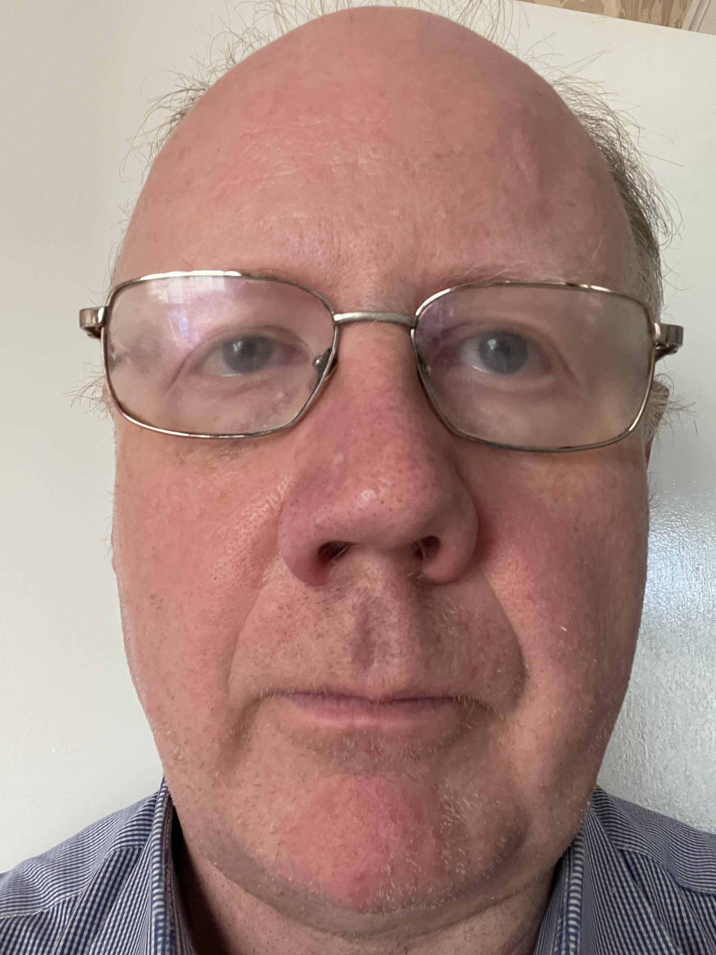
EMR Modelling / Modelling & Insights
The combined EMR Modelling and Modelling & Insights teams provide modelling expertise to support decisions relating to system adequacy. This includes modelling on operational timescales to support decisions in the ESO’s control room, as well as modelling to support decision-making on longer time horizons (e.g. through the Capacity Market, and to inform policy development to meet Net Zero).
We provide modelling expertise to support the Winter Outlook Report published in autumn each year, covering both system margins and daily operational surplus. In addition, the Modelling & Insights team provide regular updates on daily operational margins throughout the winter period at the ESO’s Operational Transparency Forum.
We also provide modelling to support recommendations to Government on system adequacy through the Capacity Market, typically covering a time horizon of 1 – 5 years ahead. This includes recommendations on capacity market auction parameters including the target capacity and technology de-rating factors. This is published in the Electricity Capacity Report each summer before industry prequalification.
We are now also looking at longer-term system adequacy through the 2030s. This is to help us anticipate the potential risks and the resources needed to ensure adequacy in a fully decarbonised power system, which will be required to meet our Net Zero targets.
The Modelling & Insights team also undertake modelling relating to forecasting ESO balancing costs, including modelling to support fixed BSUoS tariffs.
The best way to contact us is via the team email address which is monitored regularly. Alternatively, we have also provided contact details for some members of the team.
EMR modelling queries: emrmodelling@nationalgrideso.com
Andy Dobbie
Head of EMR Modelling
Leads the EMR Modelling / Modelling & Insight teams – you can contact me on any of the modelling activities undertaken by the team
Andrew.Dobbie2@nationalgrideso.com
+44 (0) 7966 551 760
Daniel Drew
Modelling & Insights Manager
You can contact me on matters relating to operational modelling including margins and balancing cost forecasting
Daniel.Drew1@nationalgrideso.com
+44 (0) 7895 301 839
Joe Findlay
EMR Analytical Manager (secondment)
You can contact me about capacity market modelling, interconnector derating and system margins in the Winter Outlook Report.
Joseph.Findlay@nationalgrideso.com
+44 (0) 7966 836 456
Gareth Lloyd
EMR Analytical Manager
You can contact me on matters relating to the capacity market target capacity and technology de-rating factors for generation and storage
Gareth.D.Lloyd@nationalgrideso.com
+44 (0) 7816 459 611
Andrew Miller
Net Zero Adequacy Modelling Manager
You can contact me on matters relating to longer-term adequacy modelling beyond the time horizon for the Capacity Market auctions.
Andrew.Miller@nationalgrideso.com
+44 (0) 7752 471438

